Slide 1
Department of mathematics
SGGSJ GOVERENMENT COLLEGE
PAONTA SAHIB

Slide 2
COURSE NAME : DIFFERENTIAL EQUATIONS
Course code : 102 TH

Slide 3
CONTENTS
Exact differential equation.
Illustrations .
Important Notes.
working method to solve exact differential equation.
Problem based on exact differential equation.

Slide 4
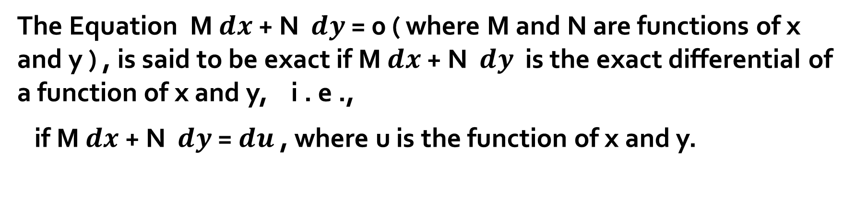
EXACT DIFFERENTIAL EQUATION
The Equation M $ⅆx$ + N $ⅆy$ = 0 ( where M and N are functions of x and y ) , is said to be exact if M $ⅆx$ + N $ⅆy$ is the exact differential of a function of x and y, i . e .,
if M $ⅆx$ + N $ⅆy$ = $ⅆu$ , where u is the function of x and y.

Slide 5
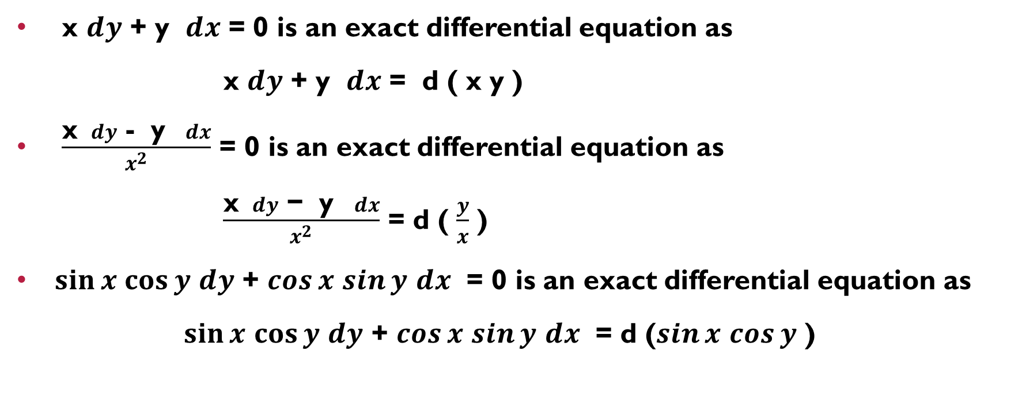
Illustrations :
x $ⅆy$ + y $ⅆx$ = 0 is an exact differential equation as
x $ⅆy$ + y $ⅆx$ = d ( x y )
$\frac{\text{x} ⅆy \text{− } \text{y} ⅆx}{x^{2}}$ = 0 is an exact differential equation as
$\frac{\text{x} ⅆy \text{− } \text{y} ⅆx}{x^{2}}$ = d ( $\frac{y}{x}$ )
$\sin{x}$ $\cos{y}$ $ⅆy$ + $\cos{x}$ $\sin{y}$ $ⅆx$ = 0 is an exact differential equation as
$\sin{x}$ $\cos{y}$ $ⅆy$ + $\cos{x}$ $\sin{y}$ $ⅆx$ = d ($\sin{x}$ $\cos{y}$ )

Slide 6
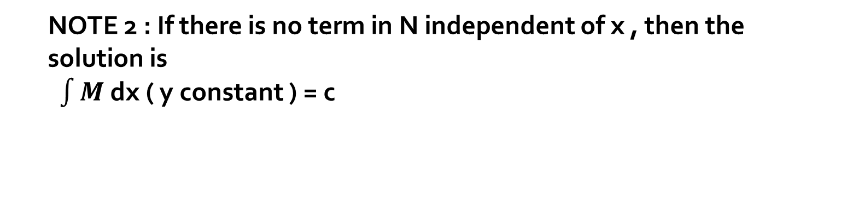
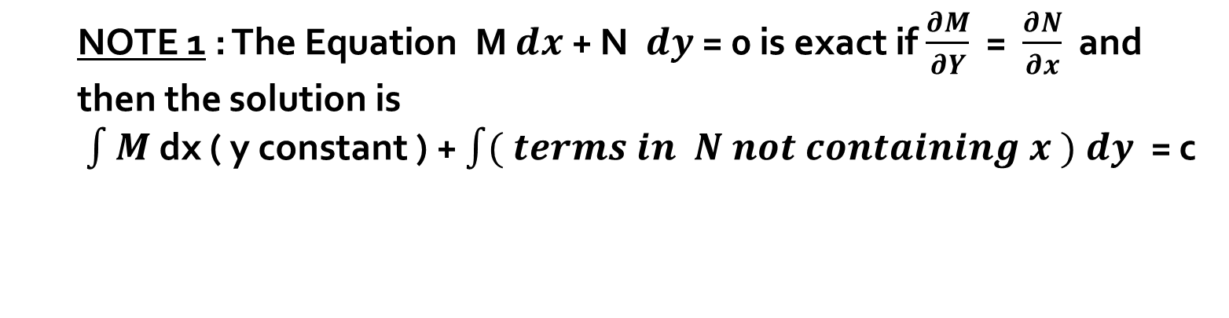
NOTE 1 : The Equation M $ⅆx$ + N $ⅆy$ = 0 is exact if $\frac{∂M}{∂Y}$ = $\frac{∂N}{∂x}$ and then the solution is
$\int{M}$ dx ( y constant ) + $\int{( terms in N not containing x )}$ $ⅆy$ = c
NOTE 2 : If there is no term in N independent of x , then the solution is
$\int{M}$ dx ( y constant ) = c

Slide 7

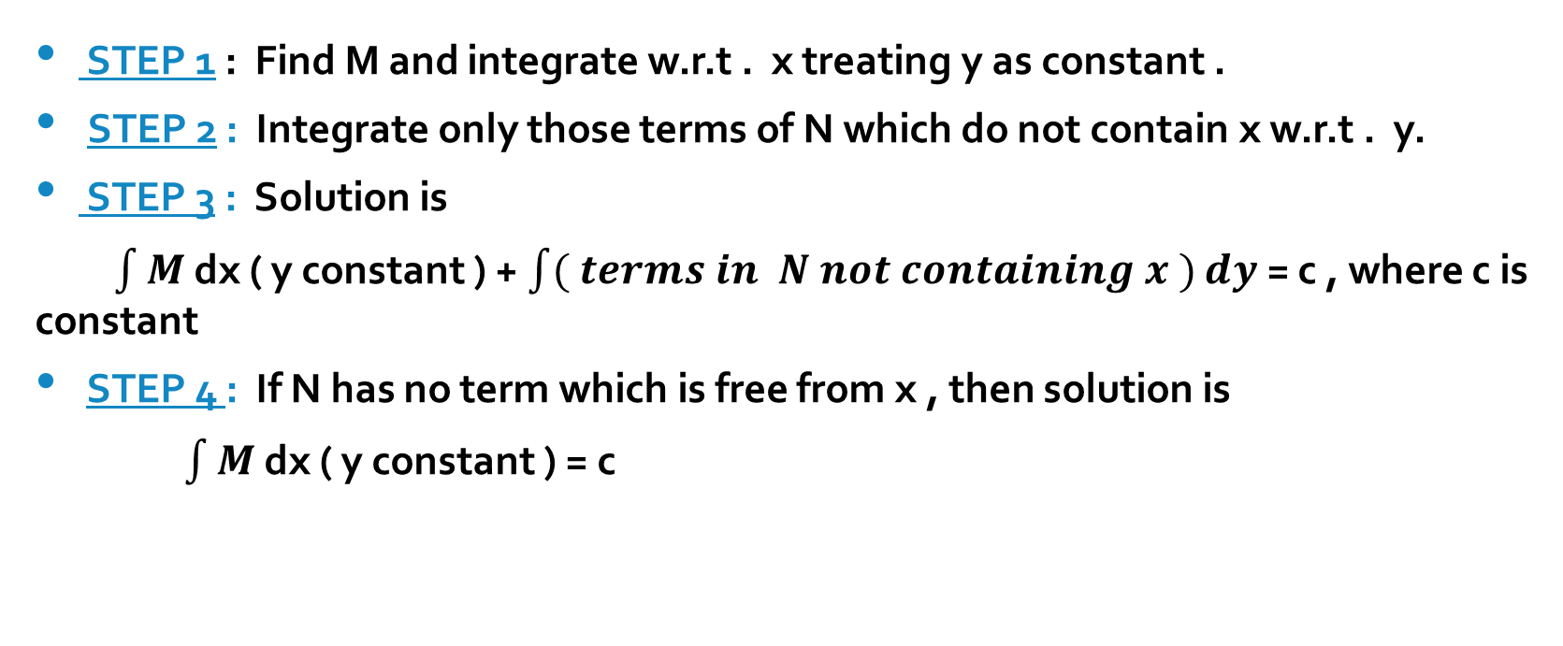
WORKING METHOD FOR SOLVING AN EXACT
DIFFERENTIAL EQUATION , M $ⅆx$ + N $ⅆy$ = 0
STEP 1 : Find M and integrate w.r.t . x treating y as constant .
STEP 2 : Integrate only those terms of N which do not contain x w.r.t . y.
STEP 3 : Solution is
$\int{M}$ dx ( y constant ) + $\int{( terms in N not containing x )}$ $ⅆy$ = c , where c is constant
STEP 4 : If N has no term which is free from x , then solution is
$\int{M}$ dx ( y constant ) = c

Slide 8
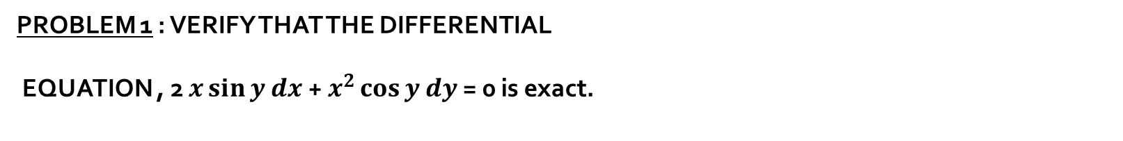
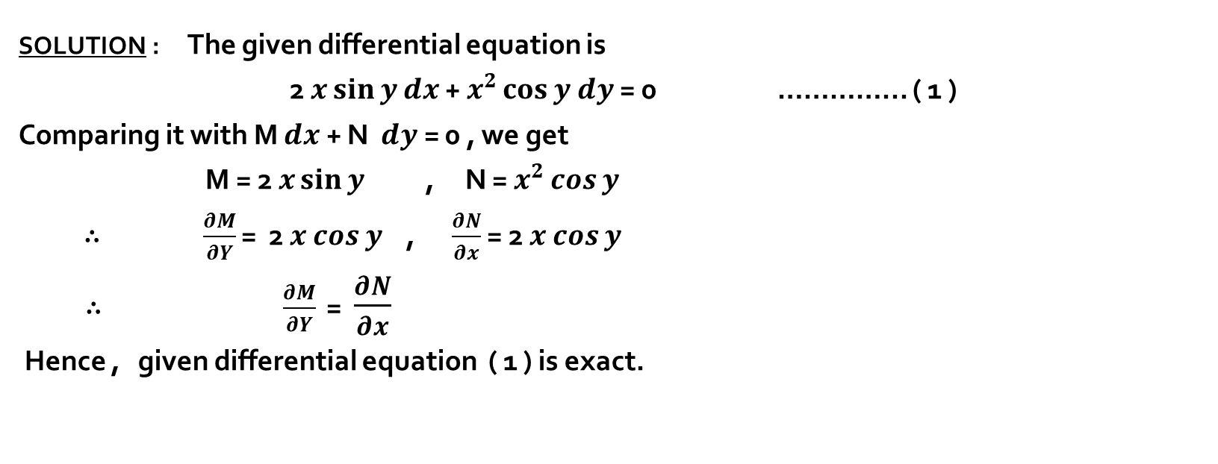
PROBLEM 1 : VERIFY THAT THE DIFFERENTIAL
EQUATION , 2 $x\sin{y}$ $ⅆx$ + $x^{2}\cos{y}$ $ⅆy$ = 0 is exact.
SOLUTION : The given differential equation is
2 $x\sin{y}$ $ⅆx$ + $x^{2}\cos{y}$ $ⅆy$ = 0 …………... ( 1 )
Comparing it with M $ⅆx$ + N $ⅆy$ = 0 , we get
M = 2 $x\sin{y}$ , N = $x^{2}\cos{y}$
∴ $\frac{∂M}{∂Y}$ = 2 $x$ $\cos{y}$ , $\frac{∂N}{∂x}$ = 2 $x$ $\cos{y}$
∴ $\frac{∂M}{∂Y}$ = $\frac{∂N}{∂x}$
Hence , given differential equation ( 1 ) is exact.

Slide 9
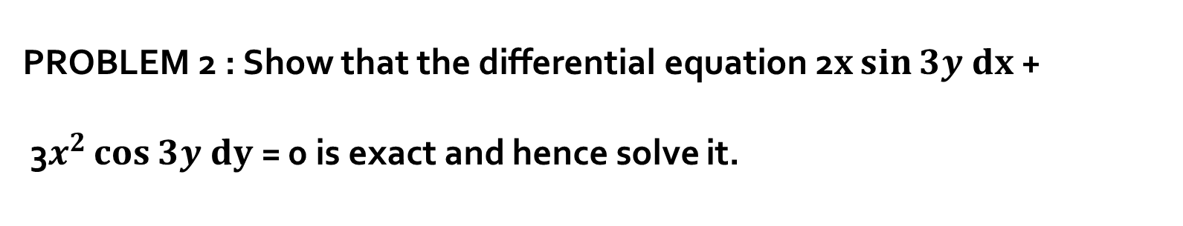
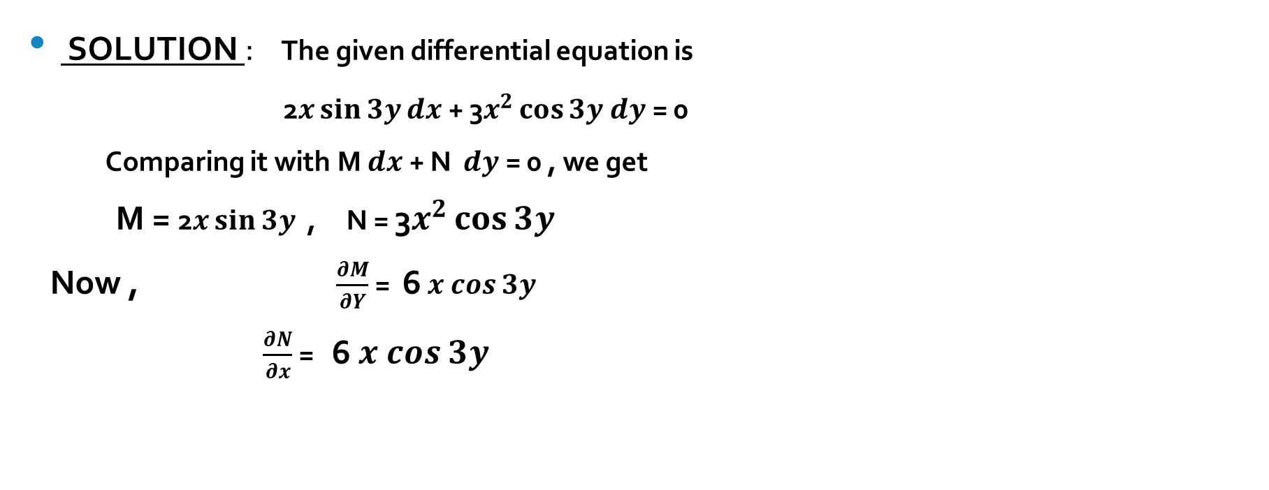
PROBLEM 2 : Show that the differential equation 2$x\sin{3y}$ $ⅆx$ +
3$x^{2}\cos{3y}$ $ⅆy$ = 0 is exact and hence solve it.
SOLUTION : The given differential equation is
2$x\sin{3y}$ $ⅆx$ + 3$x^{2}\cos{3y}$ $ⅆy$ = 0
Comparing it with M $ⅆx$ + N $ⅆy$ = 0 , we get
M = 2$x\sin{3y}$ , N = 3$x^{2}\cos{3y}$
Now , $\frac{∂M}{∂Y}$ = 6 $x$ $\cos{3y}$
$\frac{∂N}{∂x}$ = 6 $x$ $\cos{3y}$

Slide 10
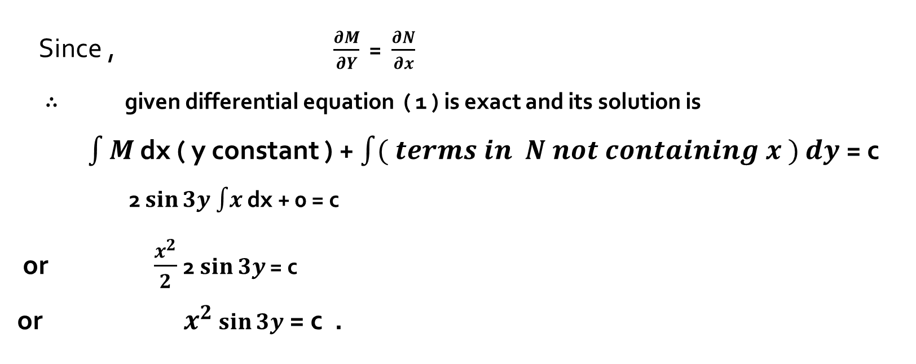
solution continues…
Since , $\frac{∂M}{∂Y}$ = $\frac{∂N}{∂x}$
∴ given differential equation ( 1 ) is exact and its solution is
$\int{M}$ dx ( y constant ) + $\int{( terms in N not containing x )}$ $ⅆy$ = c
2 $\sin{3y}$ $\int{x}$ dx + 0 = c
or $\frac{x^{2}}{2}$ 2 $\sin{3y}$ = c
or $x^{2}$ $\sin{3y}$ = c .

Slide 11
thankyou

